Slide 1
This Presentation Reflects The Views of FinFix.
The Content is Subject to Refinement and Change.
© Copyright 2016 FinFix

Slide 2
How Mortgages are Created
A Common Sense Explanation
Of The Process of Matching
Investors to Homeowners
© Copyright 2016 FinFix

Slide 3
OPPORTUNITY
PEOPLE WHO WANT
TO INVEST $$
PEOPLE WHO WANT
TO BORROW $$
© Copyright 2016 FinFix

Slide 4
FINANCIERS
DEFINE RATES, RISKS, Ts & Cs
TO MARRY INVESTORS WITH BORROWERS
CREATING PROFIT FOR FINANCIAL FIRMS
© Copyright 2016 FinFix

Slide 5
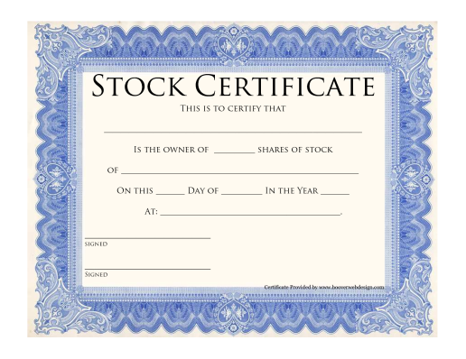
SECURITIZATION
TRUST
INVESTORS’ MONEY BECOME TRUSTS
WITH RETURNS MEASURED BY
MORTGAGE BACKED SECURITIES
© Copyright 2016 FinFix

Slide 6
DIVIDING UP THE PIE
CREATE TRANCHES & GIVE TO MORTGAGE SALES FIRMS TO SELL TO BORROWERS
© Copyright 2016 FinFix

Slide 7
SELLING
SECURITIES
TO INVESTORS
MORTGAGES
TO BORROWERS
© Copyright 2016 FinFix

Slide 8
UNDERWRITERS
DETERMINE BORROWERS
WHO WILL BE APPROVED FOR MORTGAGES
© Copyright 2016 FinFix

Slide 9
CLOSING THE DEAL
TURN OVER DONE DEALS
TO MORTGAGE SERVICING FIRMS
© Copyright 2016 FinFix

Slide 10
coming ….AND GOING
HEDGE FUND
© Copyright 2016 FinFix

Slide 11
coming ….AND GOING
PIC OF
HEDGE FUND MANAGER
WIN – WIN
© Copyright 2016 FinFix

Slide 12
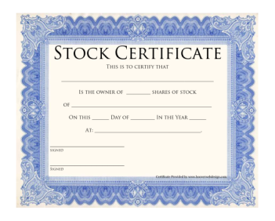
coming ….and GOING HEDGE FUNDS
MORTGAGE BACKED SECURITIES
SECURITIZATION
TRUST
MBS
USING FRONT END KNOWLEDGE OF MORTGAGE FRAUD TO TAKE ADVANTAGE OF INVESTORS IN MORTGAGE BACKED SECURITIES
© Copyright 2016 FinFix

Slide 13
coming ….and GOING HEDGE FUNDS
ADVANTAGE:
Know What Securities Will Go Naked
Hedge Fund Managers with knowledge of or involved in creating MBS for mortgages that will become fraudulent, know when and how to position their investors to gain from the losses of investors in the MBS.
© Copyright 2016 FinFix

Slide 14
coming ….and GOING HEDGE FUNDS
PROFIT FROM
HOMEOWNER & INVESTOR
Remember, Banks get paid first ….
… Then Hedge Funds get paid next
USING FRONT END KNOWLEDGE OF MORTGAGE FRAUD TO TAKE ADVANTAGE OF INVESTORS IN MORTGAGE BACKED SECURITIES
© Copyright 2016 FinFix

Slide 15
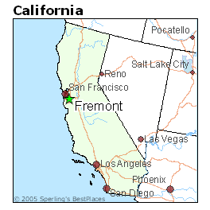
coming ….and GOING HEDGE FUNDS
Fremont MBS
Dune Capital HEDGE
PROFIT FROM
HOMEOWNER & INVESTOR
© Copyright 2016 FinFix

Slide 16
FOR MORE INFO
What’s
Up?
Financial Firms Defined
Federal Agencies & Authorities That Govern
Mortgage Creation Diagram
Contact vawilliams@FinFix.org
© Copyright 2016 FinFix

Slide 17
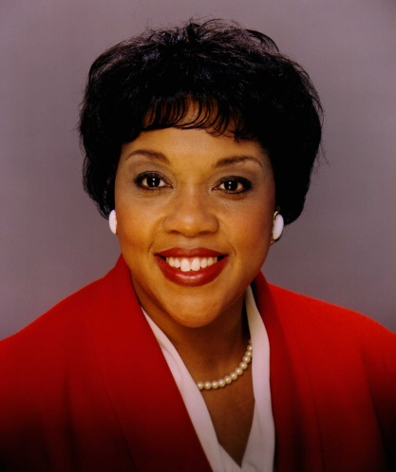
WRITTEN, NARRATED
& PRODUCED BY
VERONICA A. WILLIAMS
Kellogg MBA in Finance & Economics
FINRA Arbitrator
Crafted Solutions for banks since 1980
Other Professional Certifications PgMP, PMP, ITIL
www.VeronicaWilliams.com
https://www.LinkedIn.com/in/VeronicaWilliams
© Copyright 2016 FinFix

